Slide 1
System Analysis presentation
Md Mehedi Hasan
ID : 221-15-5976
MM Abid Hassan
ID : 221-15-5068
Rubaiyat Ferdousi
ID : 221-15-4843

Slide 2
Contents
Topic : Home Rent Management System
Objectives
Feature/Functionalities
Diagram
System Design
Future Work
Conclusion

Slide 3
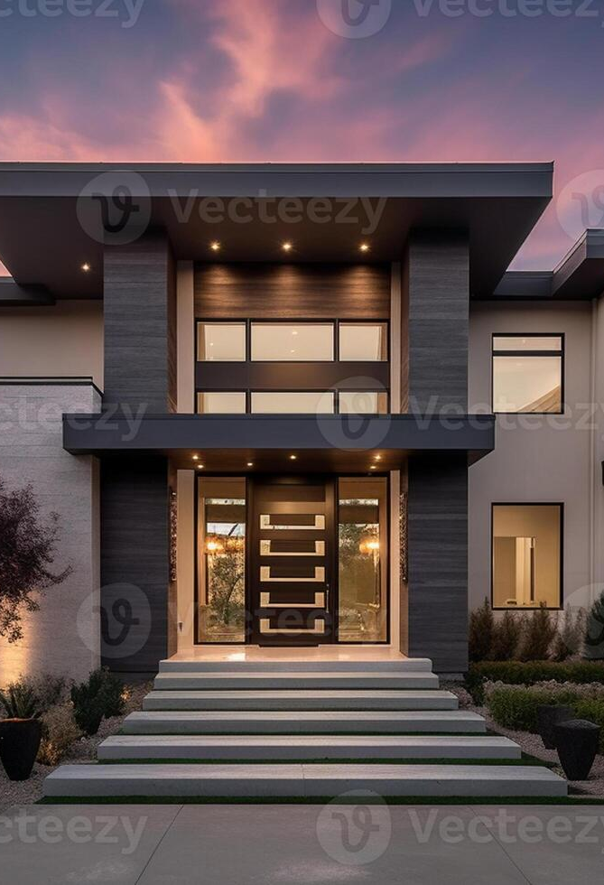
Objectives
1
Accessibility
Security
User Experience
Efficiency
Communication
Flexibility
2
3
4
5
6

Slide 4
FEATURE/FUNTIONALITIES
1. User Management
Registration / Login
Profiles
2. Property Listings
Search & Filter
Details , Photos, Location
3. Communication
Messaging
Notification

Slide 5
FEATURE/FUNTIONALITIES
4. Booking
Online
Offline
5. Management
Storage Document Securely
Process Rental Payment Securely
6. Support and Resources
Help Center
Customer Support

Slide 6
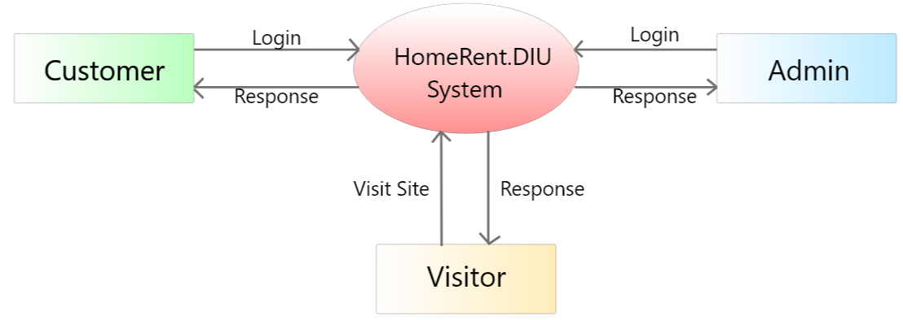
Diagram
Fig. DFD - 0

Slide 7
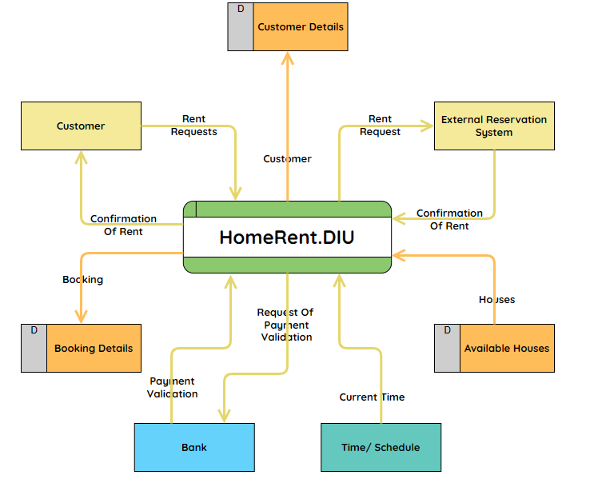
Fig. DFD – 1

Slide 8
Future Work
Ai
Voice Search & Virtual Assistance
View
360 degree view of Properties
Extend
Not only Dhaka but also whole Bangladesh
IOS
Extend IOS Version

Slide 9
Conclusion
Better relationship between tenants and owners
Designed with the aim of helping or satisfying the needs of rental house owners and renters
Assurances and Guarantees for renters and owners
Links to Additional Resources
Ease of Use and Accessibility
Social Proof and Community

Slide 10
Thank you

